Slide 1

The Rastaban project
For researching and monitoring at micro level

Slide 2
Presentation layout
Introduction Rastaban
Background/History Rastaban
My contribution to Rastaban
Plans for the future
Summary

Slide 3
Introduction Rastaban

Slide 4

Introduction Rastaban
Preperation for measurement
Heating/cooling liquid
Reaction
Combining reaction liquid with the liquid to be examined
Observation
Observing reaction for a certain time
Record
Observed images are stored on storage medium (local or online)
Goal
Observe Water Quality
Process
Automatic
Manually

Slide 5
Background Rastaban

Slide 6
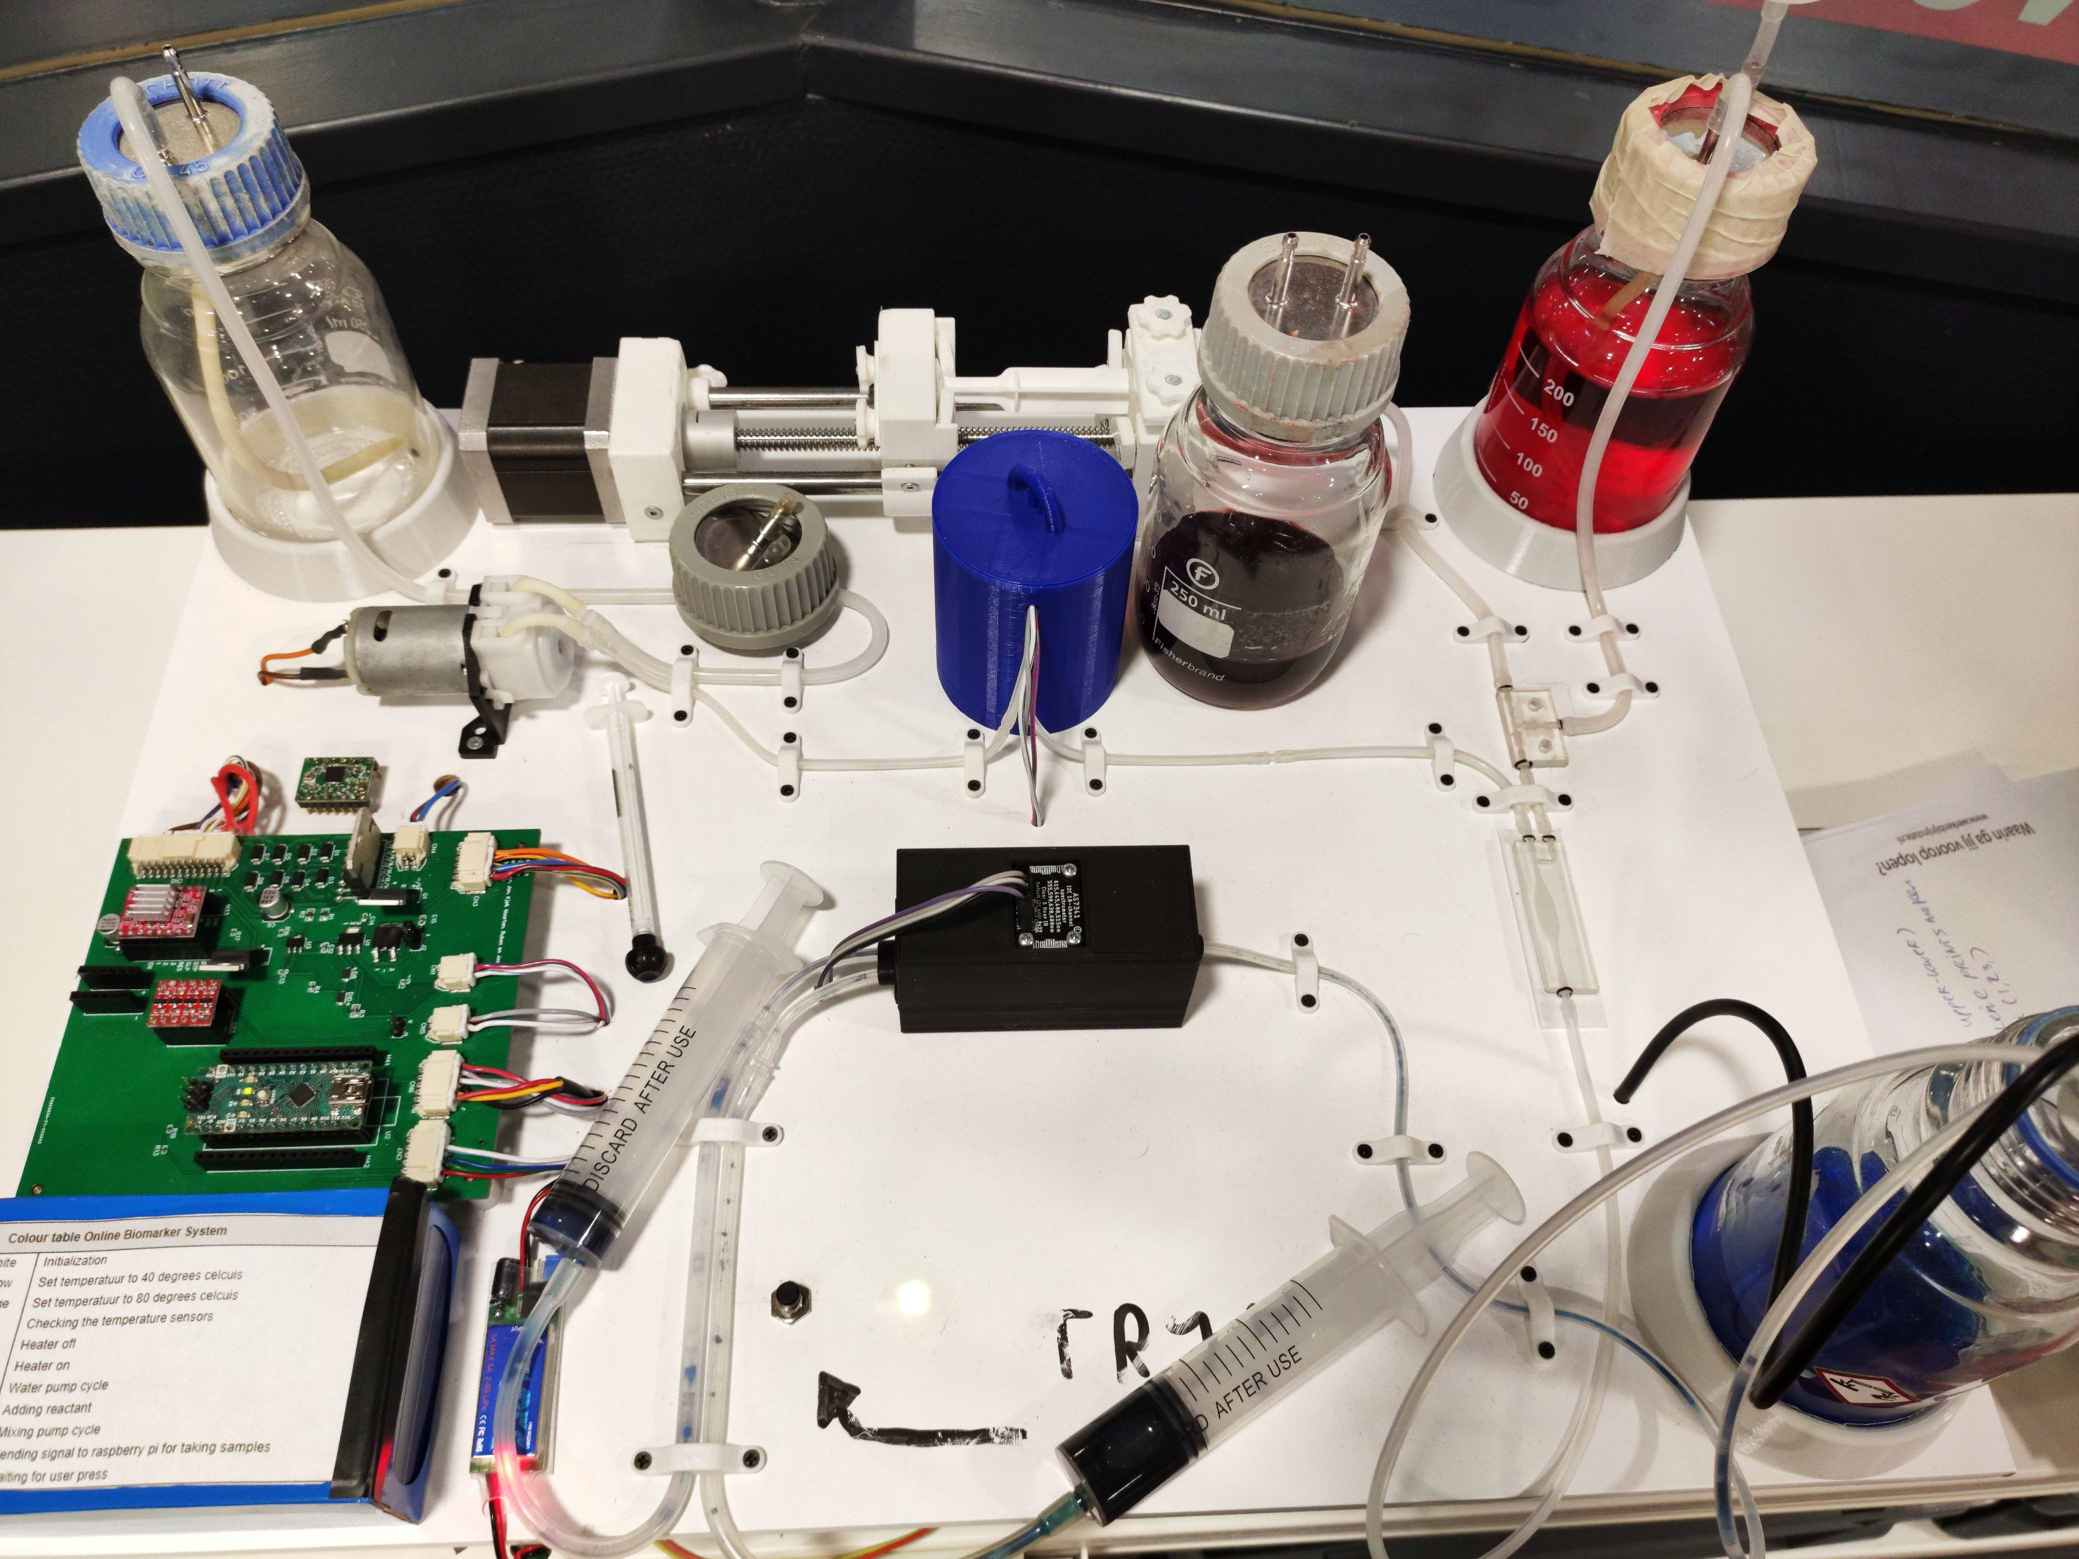
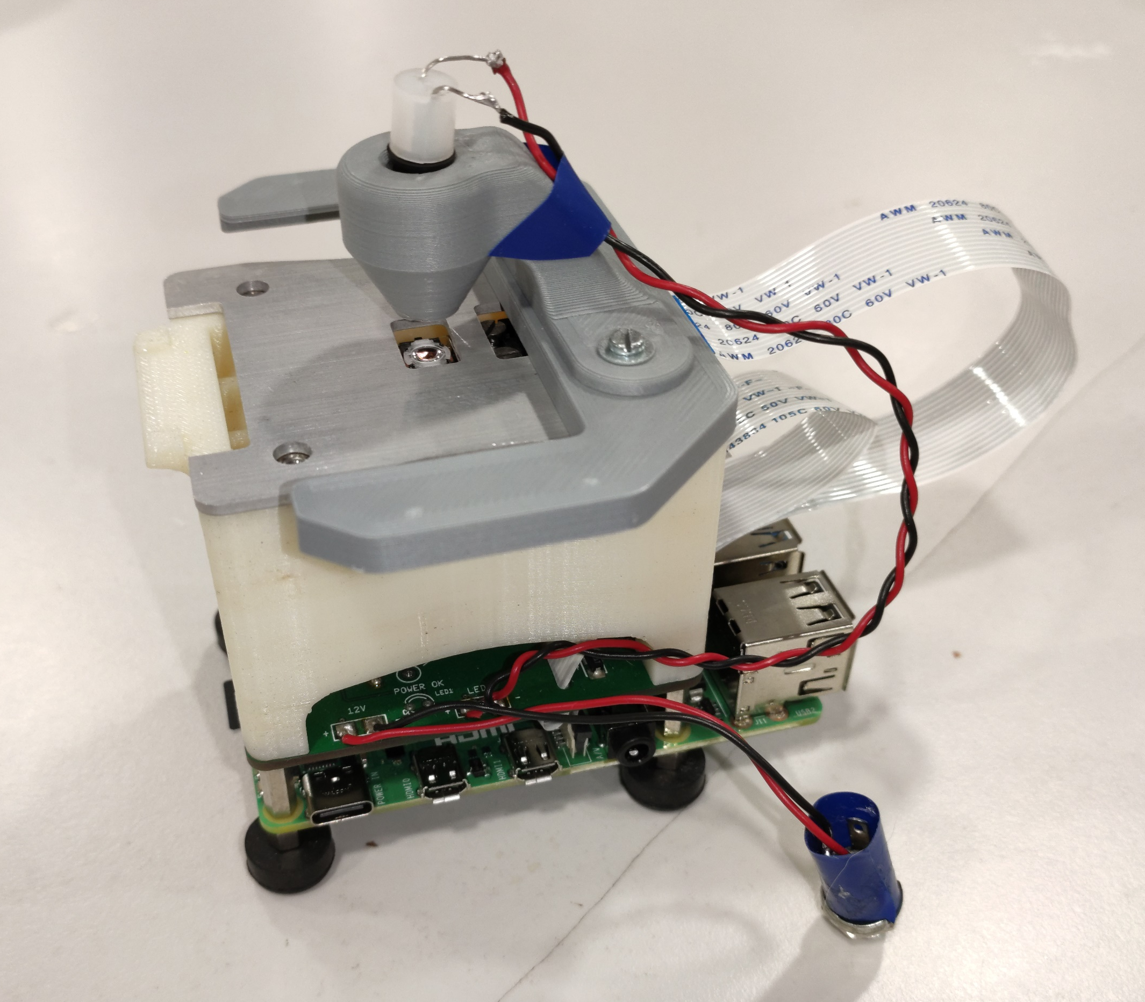
Background Rastaban
Company
HCL
Members
EE-IPD
S3-S8
Subjects
Activities
Previous Rastaban groups
S4
Focus: Camera
S6
Focus: Spectrometer

Slide 7
My contribution to Rastaban

Slide 8
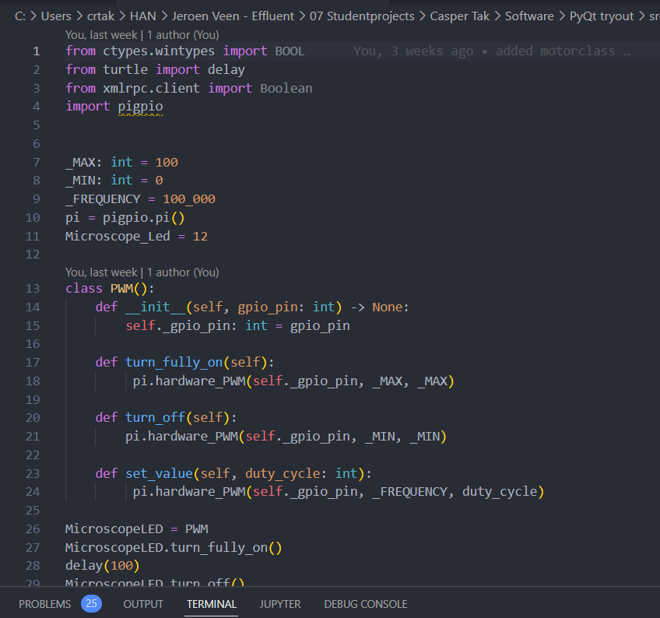
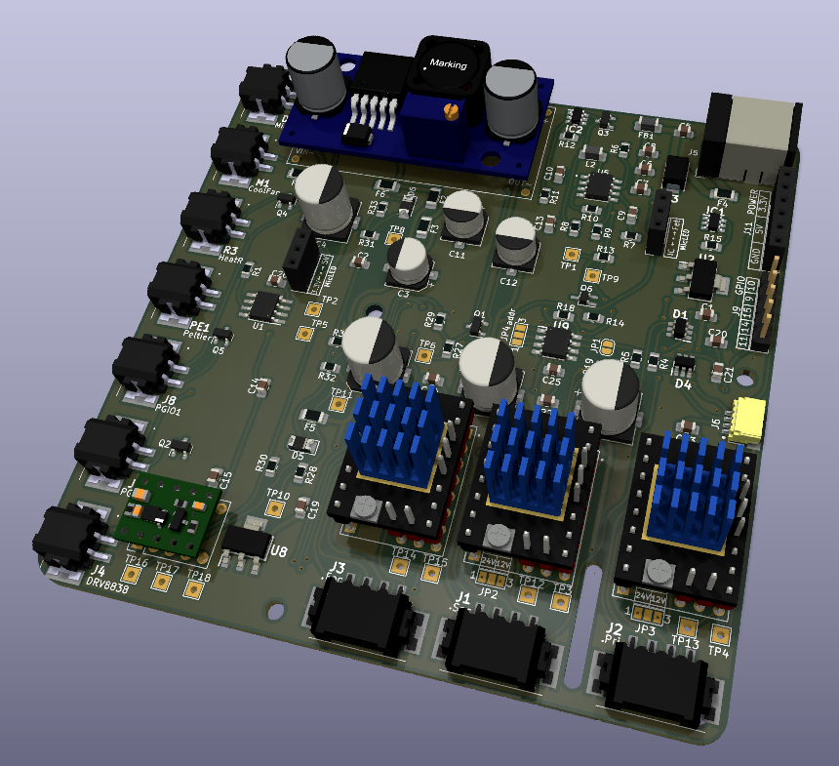
My contribution to Rastaban
In general
Fully functional prototype
Size reduction
Increase robustness
PCB
Goal
EMC/ESD
KICAD6
Pluggins
Software
Goal
Control all pheriperals
PyQt
GUI
Qt Functions

Slide 9
Future Plans

Slide 10


Future Plans
In general
Portable
Increased effiency
More robust
Water Quality Monitor
Public health
DNA

Slide 11

Summary
HCL
Goal Rastaban
My Contribution
Future goals

